Slide 1



Slide 2
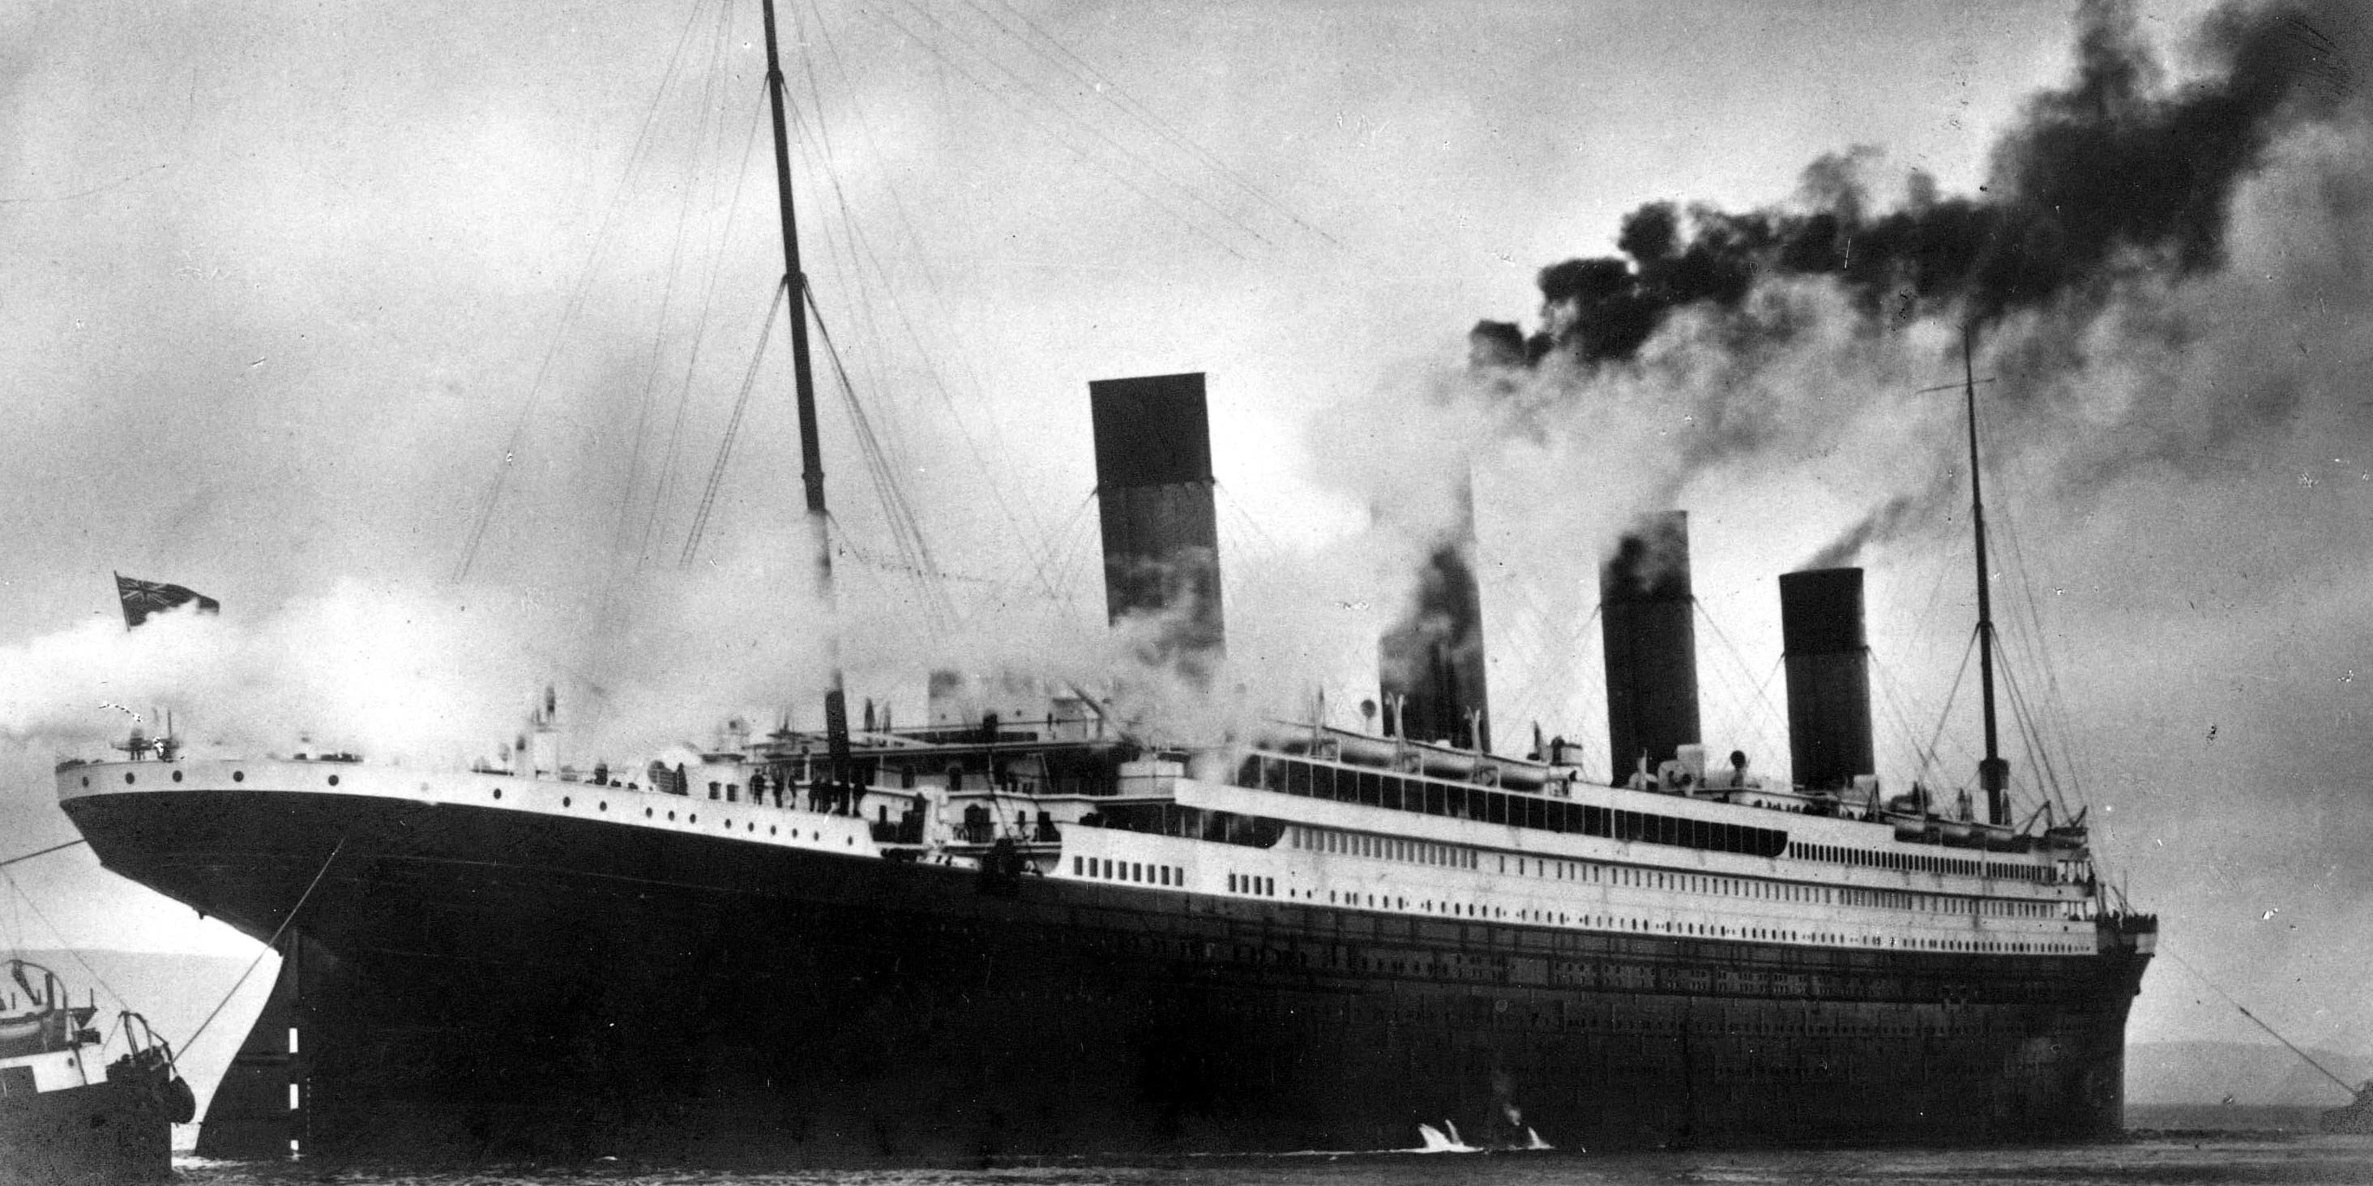
CONTENTS
Introduction
Dataset Overview
Exploratory Data Analysis
Visualizations
Model Selection
Hyperparameter Tuning
Conclusion

Slide 3
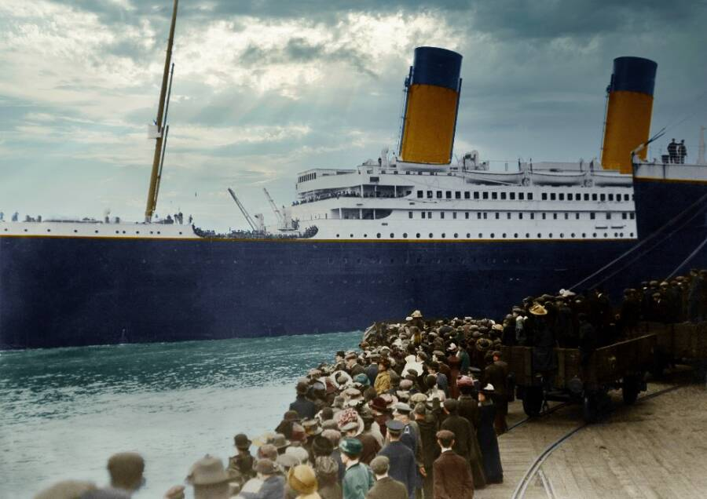
INTRODUCTION
Titanic was the largest ship built during its time and was as tall as an eleven-story building with nine decks.
The Titanic set sail on April 10, 1912, from England to America. It was considered unsinkable.
More than 1,500 people died, but the ship Carpathia rescued 705 people.
The lowest part of the Titanic was divided into sixteen watertight compartments. The Titanic could stay afloat if no more than four of the watertight compartments had water in them, but there was water in five compartments, and eventually all of them.

Slide 4

DATASET OVERVIEW
This dataset is a preprocessed version of the classic Titanic passenger list, ready for machine learning.
It contains information about each passenger, including age, sex, the number of siblings/spouses aboard (SibSp), and the number of parents/children aboard (Parch).
Due to preprocessing, all categorical data has been converted to numerical data using one-hot encoding.
Observations, Features: 891x 69
Notes:
Passenger class ('Pclass_1', 'Pclass_2', 'Pclass_3') continues to be a significant factor, with higher classes having better survival rates.

Slide 5

Data Analysis
After data analysis observed, 95 duplicate items was present. Dropped these items.
Dataset- 796x69

Slide 6
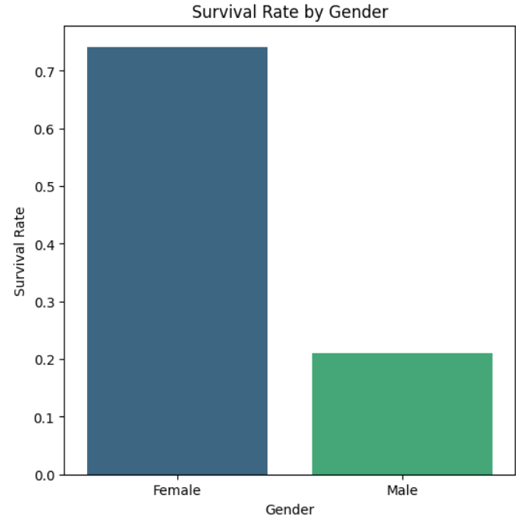
VISUALIZATION
This bar plot clearly shows that survival rate of female was comparatively higher than male.
Female - 70%
Male - 20%
This visualization immediately highlights gender as a crucial factor in predicting survival.

Slide 7
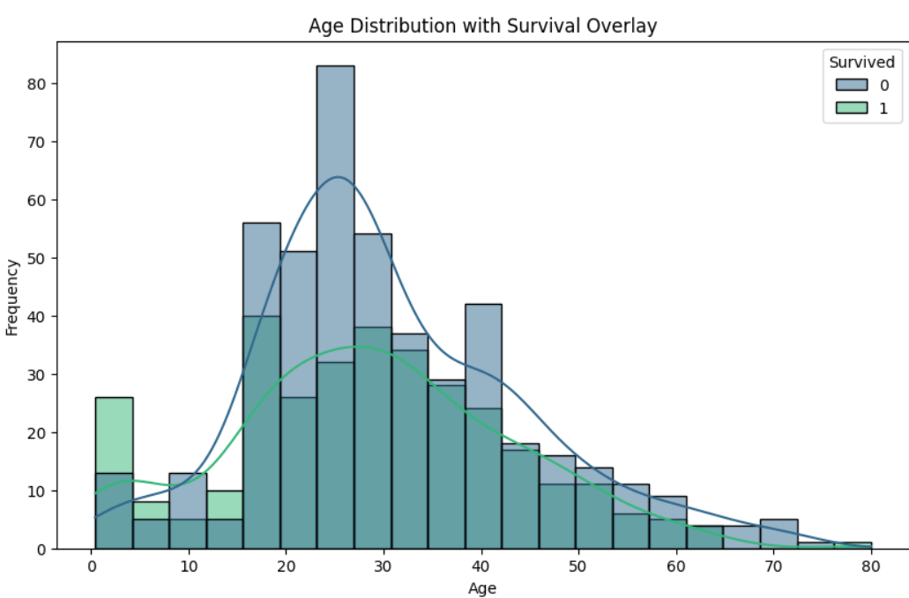
Age Distribution with Survival Overlay
(0-10): the green line is above blue for most cases, indicating high survival.
(20-30): Large portion of passengers. Indicating mixed outcome.
(30-40): The non-survival frequency is the highest for the people in the range.
(60+): Very few people in this age group and survival rate is also less.
The graph visually supports the historical narrative of "women and children first" during the disaster.

Slide 8
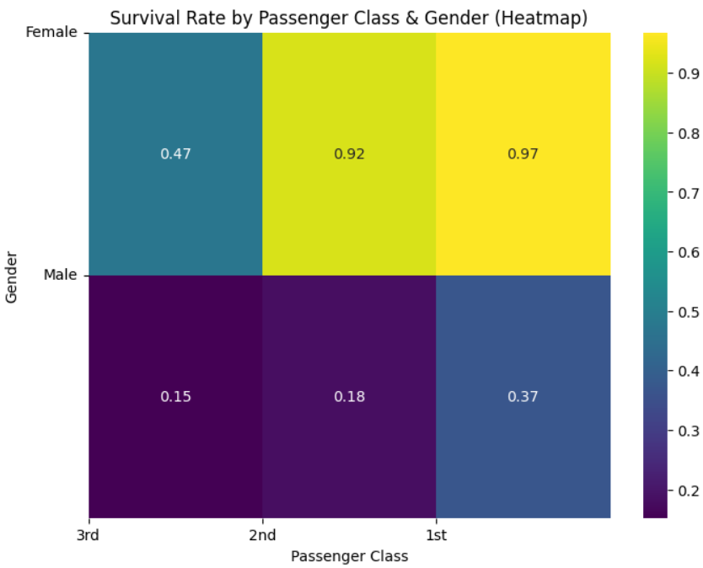
Heatmap Visualization
Yellow/Green: Higher Survival Rate
Dark: Low Survival Rate

Slide 9
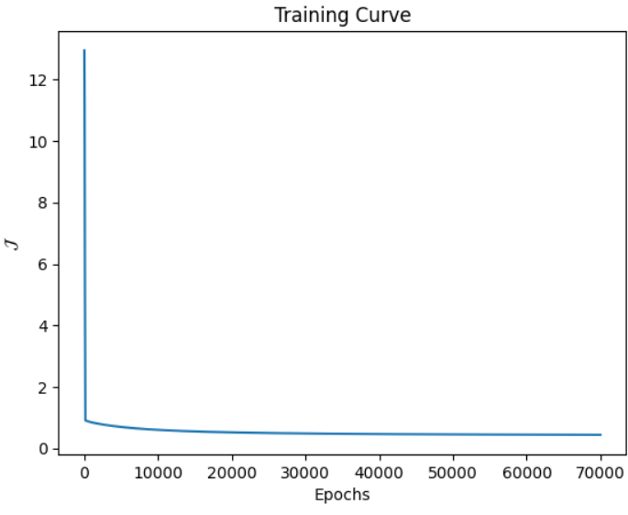
LOGISTIC REGRESSION
Logistic regression is a supervised machine learning algorithm used for classification tasks where the goal is to predict the probability.
It’s used for binary classification where we use sigmoid function, that takes input as independent variables and produces a probability value between 0 and 1.
Training Rate- 80.73
Testing Rate- 81.25

Slide 10
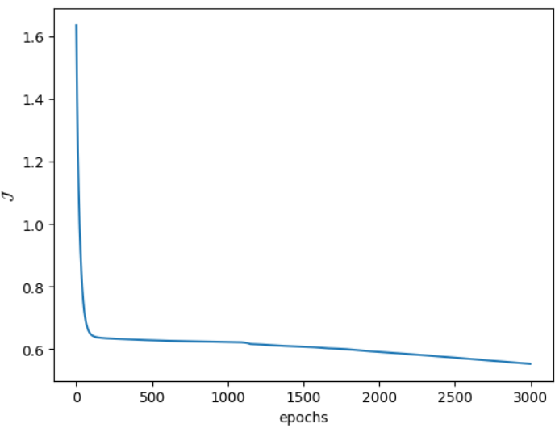
ANN (Artificial Neural Network)
ANN is a computational system influenced from the structure, processing capability and learning ability of a human brain.
Each connection is assigned a weight or numerical value determining the strength and type of influence one neuron has over another.
Training Rate - 73.6%
Testing Rate - 70%

Slide 11
Hyper parameter Tuning
Learning Rate(eta): Tried smaller learning rates to see if the model converges to a better solution.
Increase number of Iterations.
Fine tuning threshold value.
After fine tuning with above parameters, testing data was predicting well.

Slide 12

CONCLUSION
Comparing both the models, Logistic Regression performed better in predicting the survival rate than ANN for this dataset.
Next step would be to try with large dataset using ANN.

Slide 13

THANK YOU

